Slide 1
Name / Ahmed ashraf Abdelhady
Sec : 1
Traffic light controller
Second academic year .

Slide 2
Task 1
host a presentation on PIC16f877A of Microchip

Slide 3
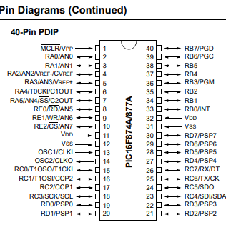
Describe all the pins of PIC16f877A:
Power & GND Pins:
VDD :Power supply (typically +5V).
VSS : Ground.
Oscillator Pins:
OSC1/CLKIN :Input to the internal oscillator or external clock input.
OSC2/CLKOUT :Output of the internal oscillator or clock output.

Slide 4
PORT_A:
PORT_B :
PORT_D :
RA0 : Digital I/O. Can also be used as an analog input (AN0).
RA1 : Digital I/O. Can also be used as an analog input (AN1).
RA2 : Digital I/O. Can also be used as an analog input (AN2).
RA3 : Digital I/O. Can also be used as an analog input (AN3).
RA4 : Digital I/O. Can also be used as a T0CKI (Timer0 external clock input).
RA5 : Digital I/O. Can also be used as an analog input (AN4) or a CCP (Capture/Compare/PWM) module output
RB0/INT : Digital I/O. Can be used as an external interrupt.
RB1 : Digital I/O.
RB2 : Digital I/O.
RB3 :Digital I/O.
RB4 : Digital I/O.
RB5 : Digital I/O.
RB6/PGC : Digital I/O. Can be used for in-circuit debugging (Programming Clock).
RB7/PGD : Digital I/O. Can be used for in-circuit debugging (Programming Data).
RD0 :Digital I/O.
RD1 : Digital I/O.
RD2 : Digital I/O.
RD3 : Digital I/O.
RD4 : Digital I/O.
RD5 : Digital I/O.
RD6 : Digital I/O.
RD7 : Digital I/O.

Slide 5
PORT_E
Another Pins:
RE0 : Digital I/O. Can also be used as an address/data bus line.
RE1 : Digital I/O. Can also be used as an address/data bus line.
RE2 : Digital I/O. Can also be used as an address/data bus line.
RE3 : Digital I/O. Can also be used as an address/data bus line.
MCLR : Master Clear Reset. Used to reset the microcontroller. Typically connected to a pull-up resistor and a capacitor to ground.
VREF+ : Reference voltage for analog-to-digital conversion (ADC) input.
VREF- : Ground reference voltage for ADC input.
T0CKI : Timer0 clock input.

Slide 6
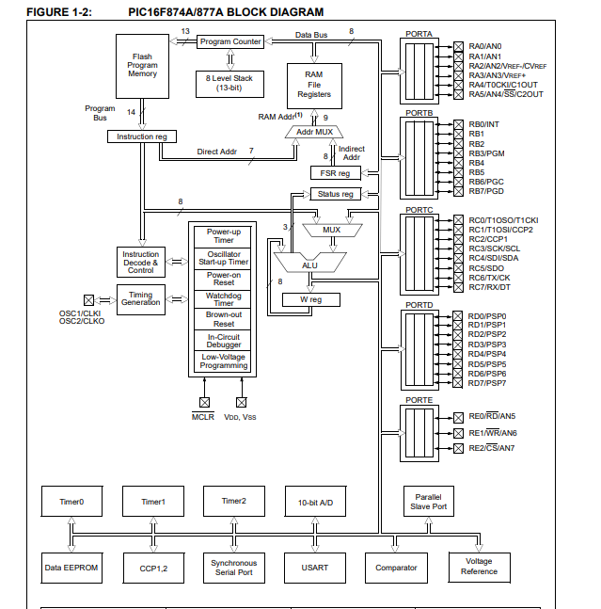
The Functions Of The Main Blocks In PIC16f877A :

Slide 7
1. ALU (Arithmetic Logic Unit):
- The ALU performs arithmetic and logic operations on the data received from the registers and memory.
- It can perform operations like addition, subtraction, AND, OR, XOR, and shift operations.
2. Status and Control:
- This block stores the status of the ALU operations and system flags like Carry, Zero, Overflow, and others.
- It controls various aspects of the microcontroller's operation, such as enabling/disabling interrupts, setting the operating mode, and managing power consumption.
3. Program Counter (PC):
- The Program Counter is a special register that holds the address of the next instruction to be fetched and executed.
- It increments automatically after fetching each instruction, pointing to the next instruction in the program memory.

Slide 8
4. Flash Program Memory:
- This is the non-volatile memory where the program code is stored.
- The program memory is typically programmed during development and retains the program even when power is removed.
5. Instruction Register (IR):
- The Instruction Register temporarily stores the current instruction being executed.
- It holds the opcode fetched from the program memory before decoding and execution.
6. Instruction Decoder:
- The Instruction Decoder is responsible for interpreting the opcode fetched from the program memory.
- It decodes the instruction to determine the operation to be performed by the ALU and other blocks.
- Based on the decoded instruction, the decoder controls the flow of data and operations within the microcontroller

Slide 9
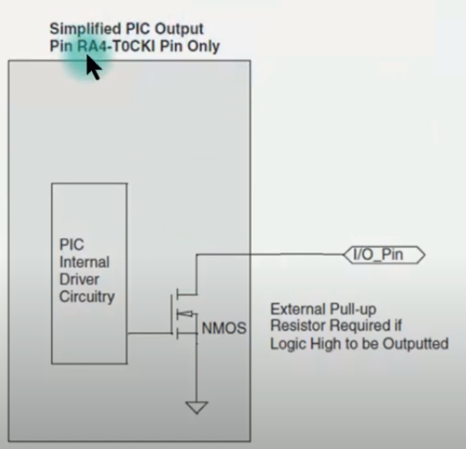
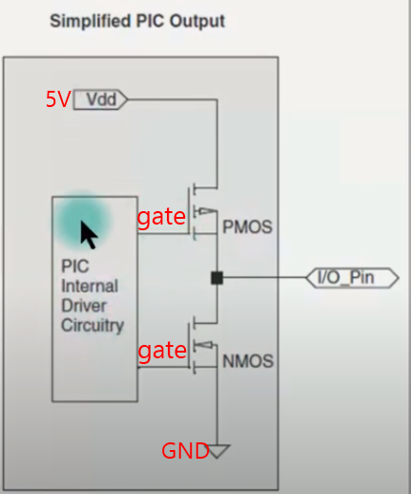
Reasons Why a Led, Which is Connected to RA4 for Flashing Not Working Probably ?
Pin A4:
Pin A4 is Digital I/O pin .
Led on A4 work when connected as sink but source the led not work.
When gate = 0V the NMOS is S.C then the led is connected between to ground and have no voltage.
When gate =5V the NMOS is O.C and the led is connected to ground and open circuit with unknown voltage .
Pin A4: another Pin:

Slide 11
Characteristics Comparison: ATMega328P vs PIC16F877A.

Slide 12
 | Memory Size | Power Consumption | Pin Count
ATMega328P | It has 32KB of Flash memory, 1KB of EEPROM, and 2KB of SRAM. | Known for its low power consumption, especially in sleep modes. | Comes in a 28-pin package.
PIC16F877A | It has 14KB of Flash memory, 368 bytes of EEPROM, and 368 bytes of RAM. | Known for its low power consumption, especially in sleep modes. | Comes in a 40-pin DIP package.

Slide 13
Examples of Embedded Systems where ATMega328P is a Better Choice:
Low Power IoT Devices:
For battery-powered IoT devices that require low power consumption, the ATMega328P's efficient power management makes it a better choice. Applications like wireless sensor nodes, smart wearables, or environmental monitoring systems benefit from the ATMega328P's low power features.
DIY Electronics and Educational Projects:
In scenarios where simplicity and ease of programming are essential, the Arduino Uno, which uses the ATMega328P, is a popular choice for hobbyists, students, and educators. Projects like simple robotics, home automation systems, and interactive art installations can benefit from the Arduino ecosystem and the versatility of the ATMega328P.

Slide 14
task2
Traffic light controller

Slide 15
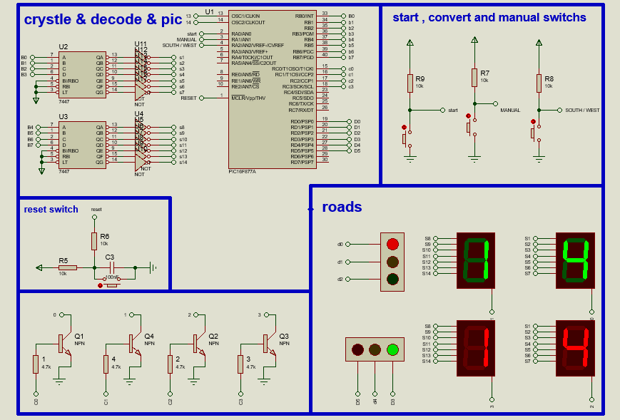
The circuit

Slide 16
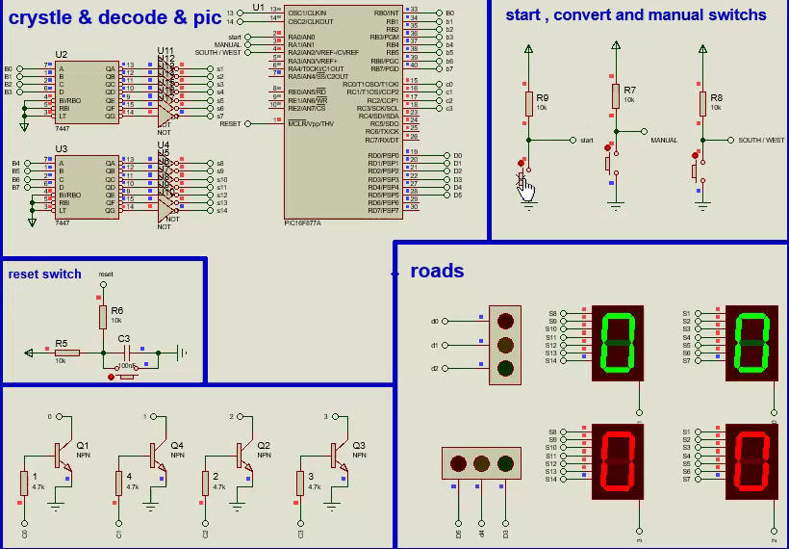
Video of the circuit

Slide 17
Components :
MUC PIC16f877A
2 *IC 7477
4* Press Button
Cap 100nf
2* cap 33pf
Crystal
16 * Not Gate
4* NPN transistor
4*res 4.7k ohm
5*res 10k ohm
4* 7 segment common cathode
2* traffic light

Slide 18
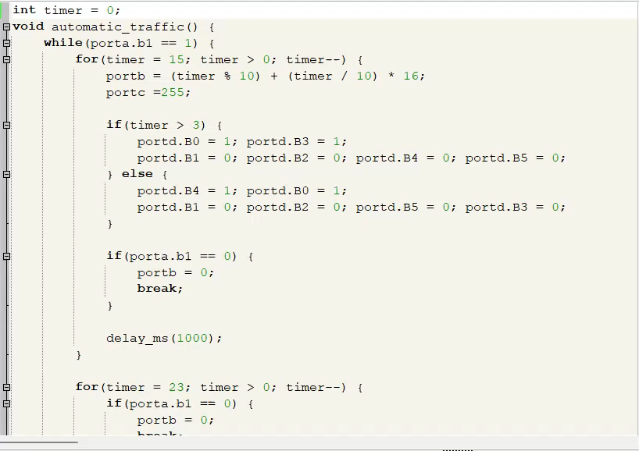
Code :

Slide 19
Mechanism :
Traffic light using PIC16f877A , 7447 ic with Start Switch And Manual/Automatic Switch
PIC16F877A Microcontroller: The PIC16F877A serves as the brain of the traffic light controller. It controls the overall operation of the traffic lights, manages the timing of each phase, and interfaces with the 7447 IC to display the countdown time.
7447 IC: The 7447 IC is a BCD to 7-segment decoder/driver that takes a BCD input from the microcontroller and drives a 7-segment display to show the countdown time for each traffic light phase. It simplifies the process of displaying numerical values on 7-segment displays.
Operation: The PIC16F877A is programmed to control the sequencing of the traffic lights (red, green, yellow) based on predefined timing intervals. The microcontroller sends BCD signals to the 7447 IC to display the countdown time for each phase on the 7-segment displays and take only 4 pins.
Interfacing: The PIC16F877A interfaces with the 7447 IC through its GPIO pins. The microcontroller sends BCD data to the 7447 IC to select the appropriate 7-segment display segments to light up based on the countdown time.
The chip programmed with mikroC pro.

Slide 20

Thanks for attention .

